Slide 1
2023-BS-AI-017
Computer Networks
Humna Imran
Lab #1: Introduction to Cisco Packet Tracer
This lab introduces the fundamentals of IP addressing, subnetting, and the Cisco Packet Tracer tool — essential skills for any aspiring network engineer.
Lab Outcomes
By the end of this lab, you will be able to:
IP Addressing
IP Address Classes
Understand what an IP address is and how it acts as a logical address for devices on a network.
Identify the different classes of IP addresses (Class A, B, C, D, and E) and know which ones are used for different network sizes.
Subnetting
Cisco Packet Tracer
Explain the concept of subnetting and how it divides large networks into smaller, more secure, and efficient pieces.
Successfully download, install, and launch the Cisco Packet Tracer software on your computer.

Slide 2

IP Addresses, Classes & Subnetting
What is an IP Address?
The Classes of IP Addresses
Think of an IP address like a house address, but for your computer or phone. It is a unique number given to any device on a network so they can find and talk to each other.
IP addresses are grouped into "Classes" based on the size of the network. Here is how they are divided:
Class
Range
Capacity
Logical vs. Physical: An IP address is "logical" (it can change depending on what network you connect to), while a MAC address is "physical" and tied to the device's actual hardware.
IPv4: The standard 32-bit IP address that most devices use today.
IPv6: Because the world is running out of IPv4 addresses, we created IPv6, which is much longer (128-bit) and provides way more addresses.
Public IP: Your global address given by your internet provider, used to talk to the wider internet.
Private IP: A local address used only inside your home or school network, keeping devices hidden from the outside internet.
A
1.0.0.0 – 126.255.255.254
Up to 16 million devices
B
128.1.0.1 – 191.255.255.254
Up to 65,000 devices
C
192.0.1.1 – 223.255.254.254
Up to 254 devices
D
224.0.0.0 – 239.255.255.255
Reserved for multicasting
E
240.0.0.0 – 254.255.255.254
Reserved for future / experimental use
Fun Fact: Addresses starting with 127 are reserved for "loopback" — a way for a computer to send a message to itself to test if its own network card is working.
Subnetting & Supernetting
Subnetting is like taking a giant pizza and slicing it into smaller, manageable pieces. In networking, it means dividing a large network into smaller mini-networks to improve speed, security, and efficiency. Supernetting is the exact opposite — combining multiple small networks into one large one.
Total Subnets
Usable Devices (Hosts)
Calculate this using 2ⁿ, where n is the number of bits borrowed for the network.
Calculate this using (2ʰ) − 2, where h is the bits left for devices. We subtract 2 because the very first and very last address of a network are always reserved.

Slide 3
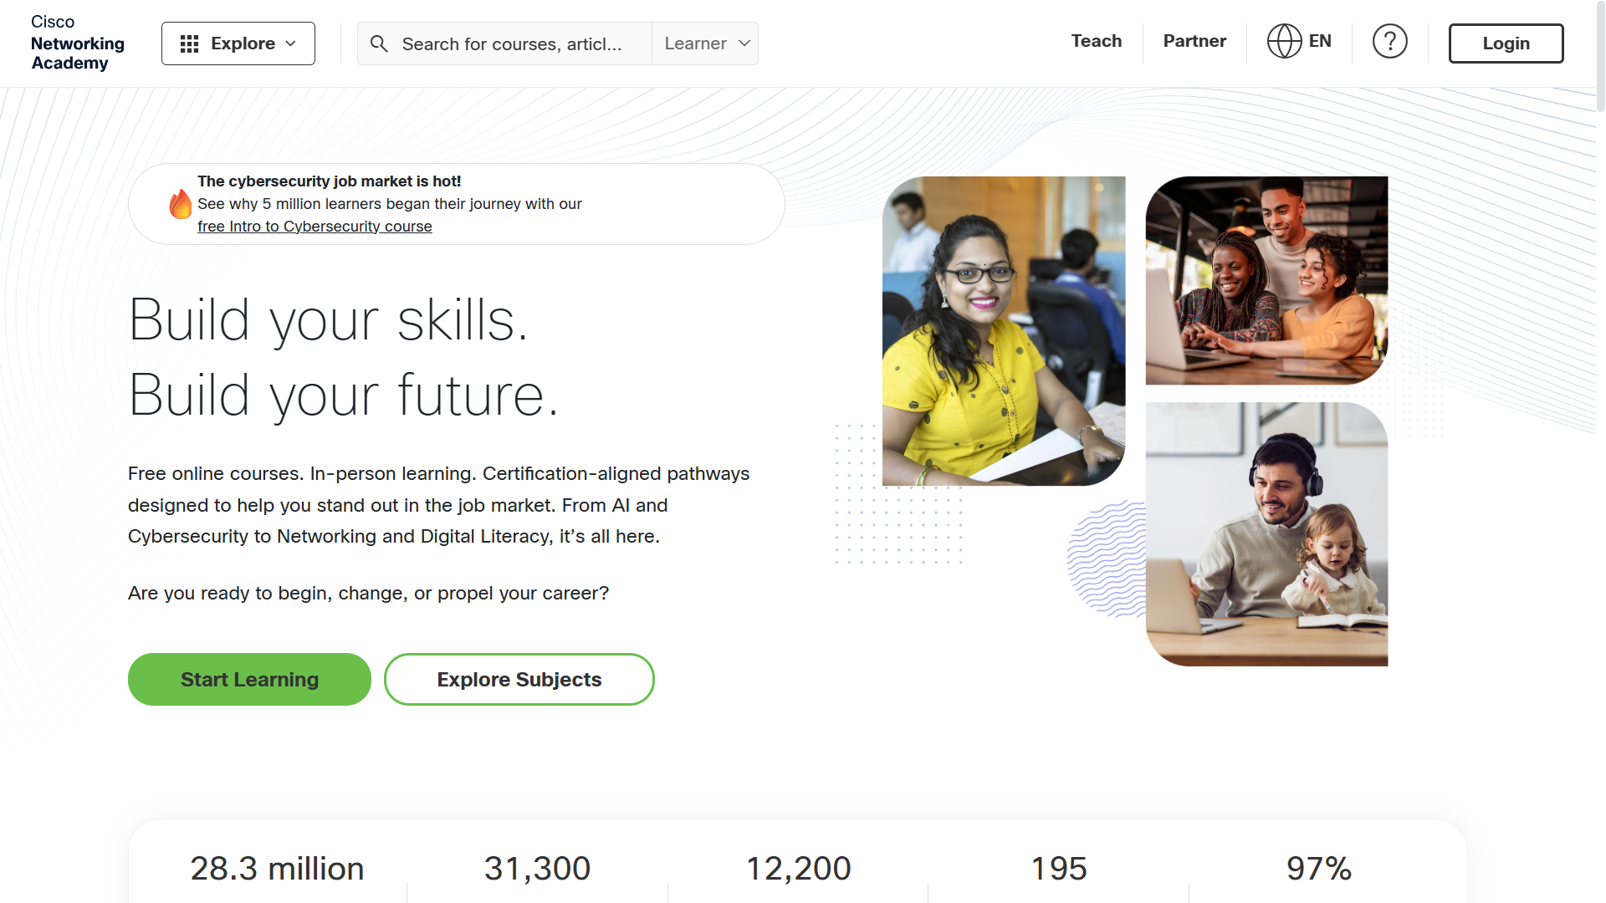
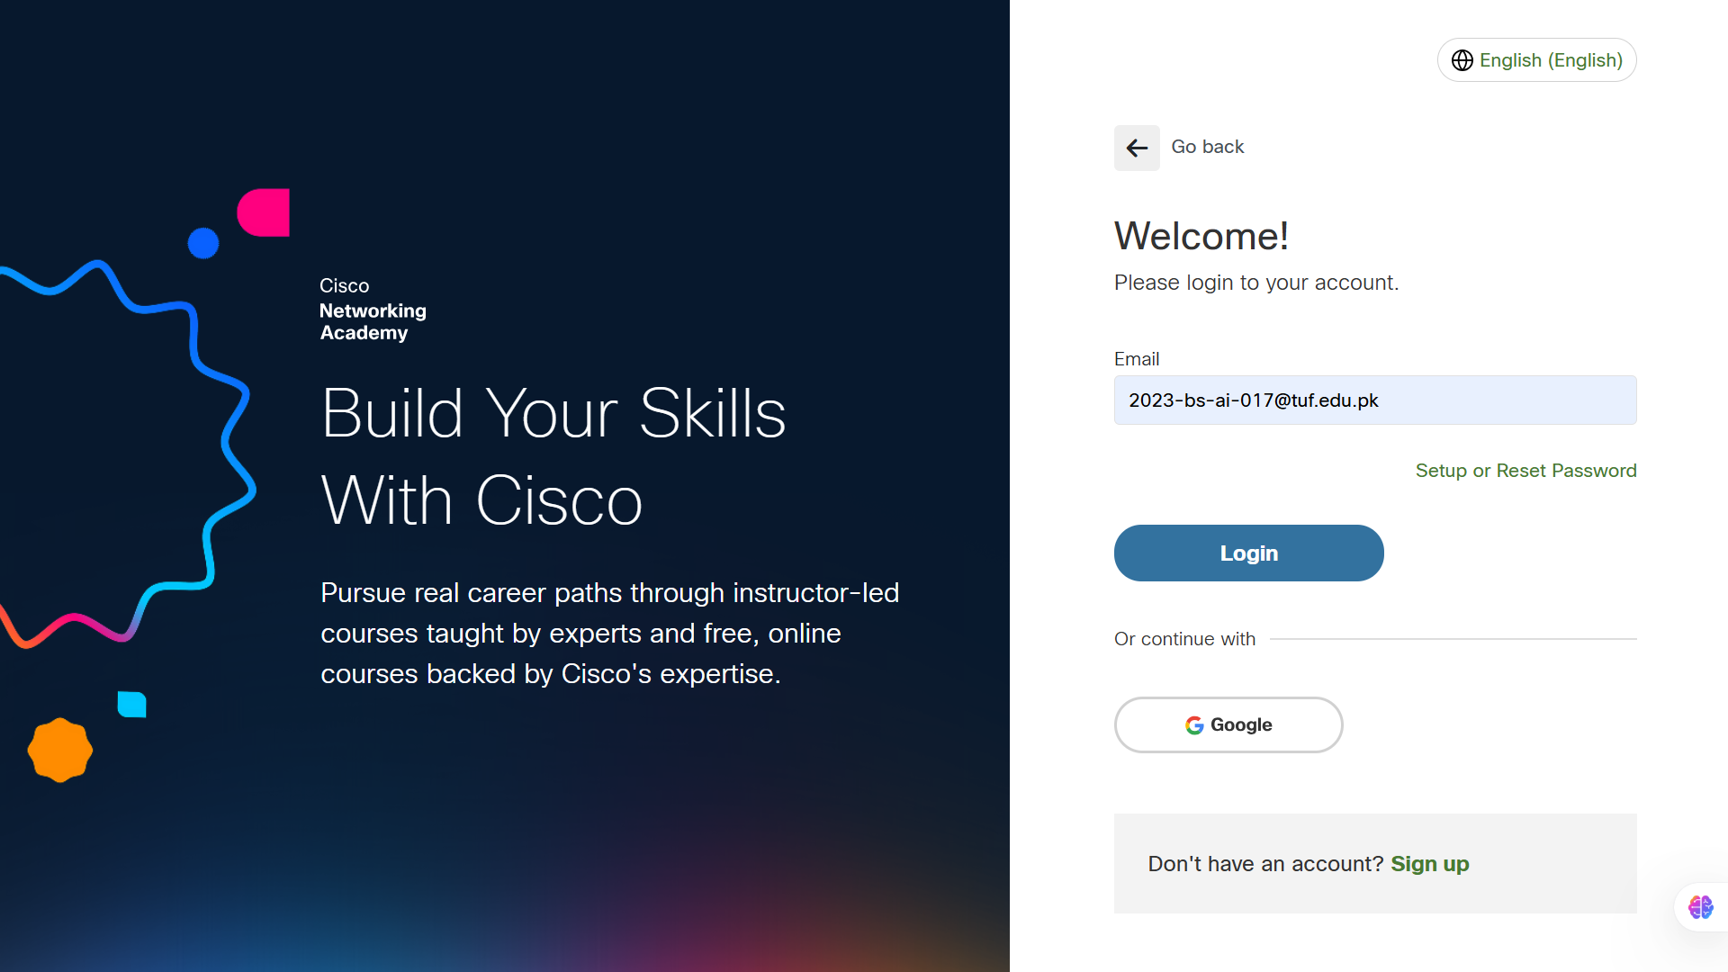
Installing Cisco Packet Tracer
Cisco Packet Tracer is a tool that lets you practice building networks safely on your computer. Follow these steps to get it running:
01
Open your web browser
Go to the official Cisco Network Academy download page.
02
Log in
Use your university or school email address.

Slide 4
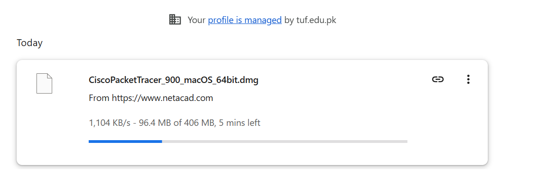
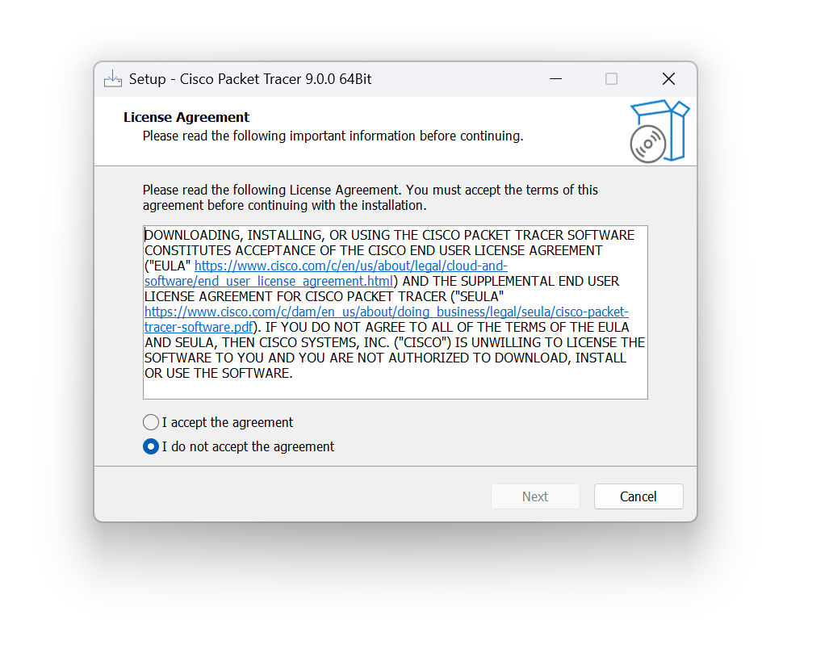
03
Download the setup file
Download the setup file for your computer.
04
Run the installer
Open the downloaded .exe file and let the installation wizard guide you.
05
Accept the License Agreement
Read and accept the Digital License Agreement when it pops up, then hit install.

Slide 5
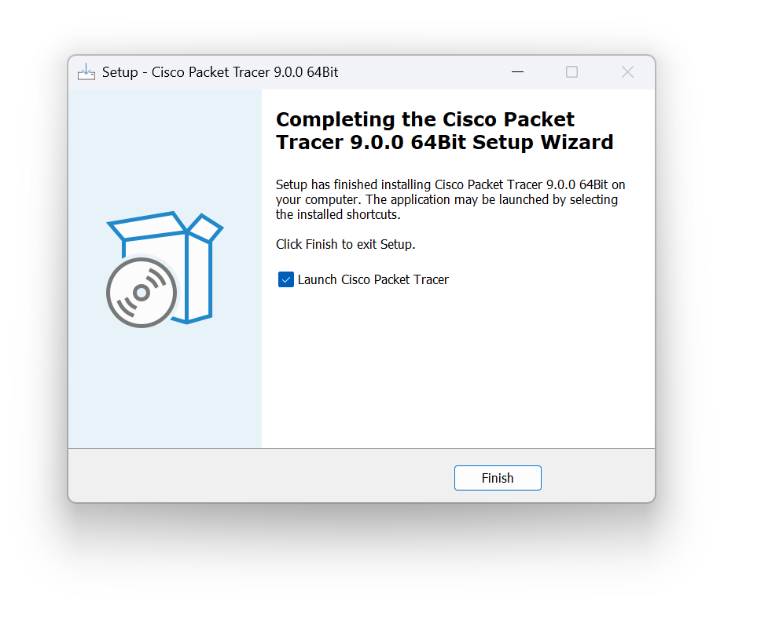

06
Finish & Launch
Click "Finish" once it completes. Open the app! You can log in to start your trial. If you want to skip the login screen entirely, just disconnect your computer from the Wi-Fi before opening the app.
Lab Work Recap: This lab covered three parts — (1) Understanding Network Addresses (comparing IP vs MAC addresses, reviewing IPv4 vs IPv6, memorizing IP address classes), (2) Subnetting Calculations (practicing 2^n for subnets and (2^h)-2 for usable hosts), and (3) Installing Cisco Packet Tracer (downloading from Cisco Network Academy, running the installer, accepting the license agreement, and launching the app).

Slide 6
Lab # 2: IP Assigning, Commands for CMD, Labeling method, Simple packet Transformation
By the end of this lab, you will be able to use the Labeling Method to keep your digital workspace neat and organized, successfully Assign an IP Address to a computer using the visual interface, use basic CMD (Command Prompt) Commands to check your settings and test connections, and perform a Simple Packet Transmission to visually watch data travel from one computer to another.

Slide 7
Lab Work: Step-by-Step
Part 1: The Labeling Method
Part 2: IP Assigning
Before building a big network, it is important to stay organized!
Now we have to actually program those addresses into the computers so they can communicate.
Step 1: Open Cisco Packet Tracer and drag two PCs onto your blank white workspace from the bottom-left menu.
Step 2: Select the Place Note tool (it looks like a little sticky note or piece of paper at the top).
Step 3: Click next to your first PC and type a label for it, like "PC 1 - 192.168.1.10". Do the same for the second PC ("PC 2 - 192.168.1.11"). This helps you remember which address belongs to which computer!
Step 4: Click directly on PC 1. A window will pop up.
Step 5: Go to the Desktop tab at the top of that window, then click on IP Configuration.
Step 6: Type 192.168.1.10 into the IPv4 Address box. When you click the "Subnet Mask" box below it, it will automatically fill in 255.255.255.0. Close the window.
Step 7: Repeat this exact process for PC 2, but use the address 192.168.1.11.
Part 3: Commands for CMD
Part 4: Simple Packet Transformation
Let's make sure the computer knows its own address!
Now for the best part—watching a message actually travel across the screen!
Step 8: Click on PC 1 again and stay on the Desktop tab. This time, click on Command Prompt.
Step 9: Type ipconfig and hit Enter. This command tells the computer to show you its network settings. You should see the IP address you just typed in!
Step 10: Now, let's test if PC 1 can "hear" PC 2. Type ping 192.168.1.11 and hit Enter. If you see replies coming back, your computers are ready to talk!
Step 11: In the bottom right corner of Packet Tracer, click on Simulation (it switches you out of "Realtime" mode).
Step 12: At the top of the screen, click the Add Simple PDU button (it looks like a closed envelope).
Step 13: Click on PC 1 (the sender), and then click on PC 2 (the receiver). You will see a tiny envelope appear on PC 1.
Step 14: Click the Play button in the Simulation Panel. Watch the envelope travel from one computer to the other and back! This is exactly how data moves across the internet.

Slide 8
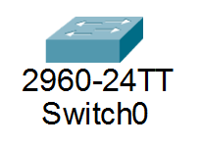
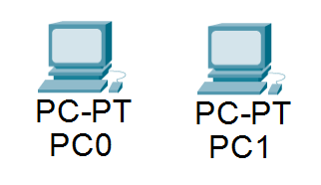
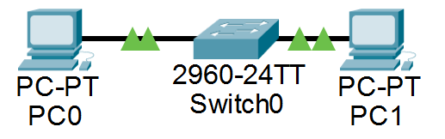
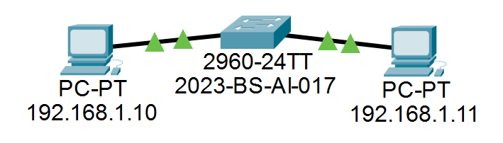
Reference Data
1. The Equipment Data
Before you enter any numbers, you need to drag these items onto your blank workspace.
1x Switch
2x PCs
Connections
Go to Network Devices > Switches and select the 2960 switch. Drag it to the middle of the workspace.
Go to End Devices, select PC, and drag two of them onto the screen.
Go to Connections (the lightning bolt icon), select the solid black line (Copper Straight-Through), and connect PC 1 to the Switch, and PC 2 to the Switch.
2. The Labeling Data
Use the Place Note tool to add these exact text labels next to your computers so you do not forget their addresses.
Device
Text to Type on the Label
First Computer
PC 1 - 192.168.1.10
Second Computer
PC 2 - 192.168.1.11
3. The IP Configuration Data
Click on each PC, go to the Desktop tab, open IP Configuration, and type in these exact numbers.
For PC 1
For PC 2
IPv4 Address: 192.168.1.10
Subnet Mask: 255.255.255.0 (This usually fills in automatically when you click the box)
IPv4 Address: 192.168.1.11
Subnet Mask: 255.255.255.0

Slide 9
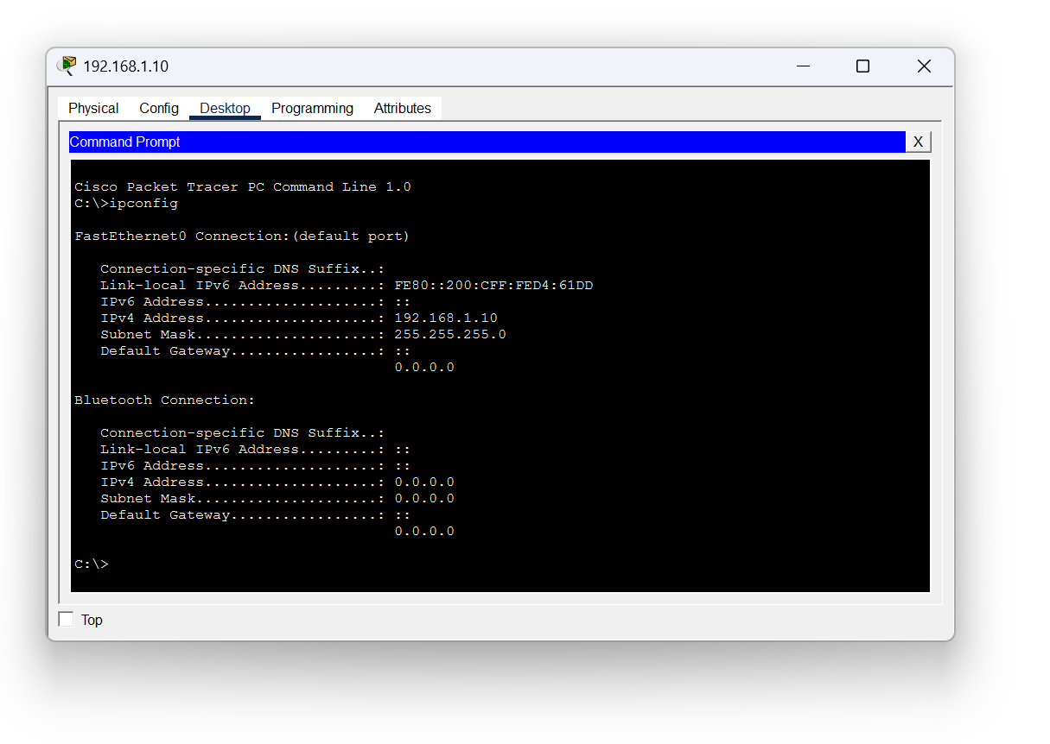
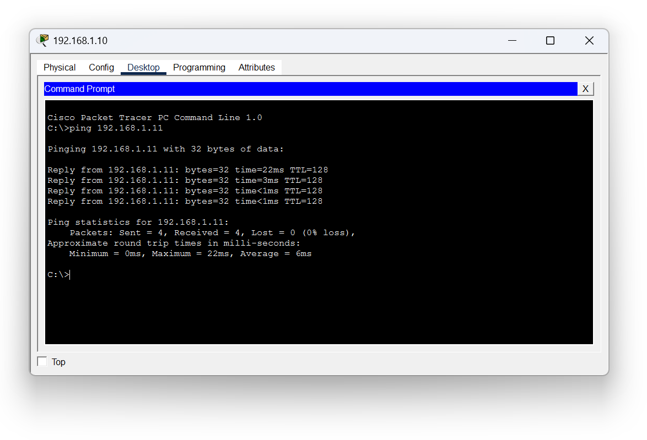
4. The Command Prompt (CMD) Data
To test if everything is working, click on PC 1, go to the Desktop tab, and open Command Prompt. Type these exact commands and hit Enter after each one.
ipconfig
ping 192.168.1.11
This will show you the address you just typed in to confirm it saved.
This tells PC 1 to send four test messages to PC 2. If it works, you will see a message saying "Reply from 192.168.1.11".

Slide 10

Lab # 3: Constructing a Basic Network Using Two Personal Computers
This hands-on lab walks you through building your very first computer network using Cisco Packet Tracer — no command-line expertise required. Follow each step carefully and you'll have two PCs communicating by the end of the session.
Lab Outcomes
By the end of this lab, you will be able to:
Place Devices
Navigate the Interface
Add computer devices onto your workspace from the device panel.
Move confidently around the Cisco Packet Tracer workspace.
1
2
3
4
5
Choose the Correct Cable
Select the right physical cable to connect two identical devices.
Test the Connection
Verify visually that the two computers can communicate with each other.
Assign an IP Address
Give each computer a digital "home address" using visual menus.

Slide 11
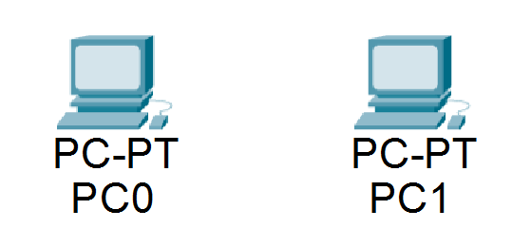
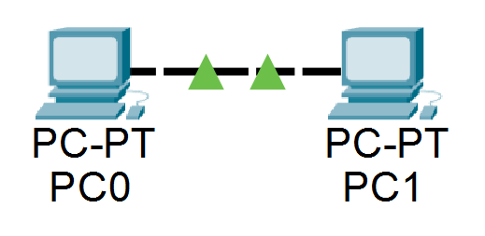
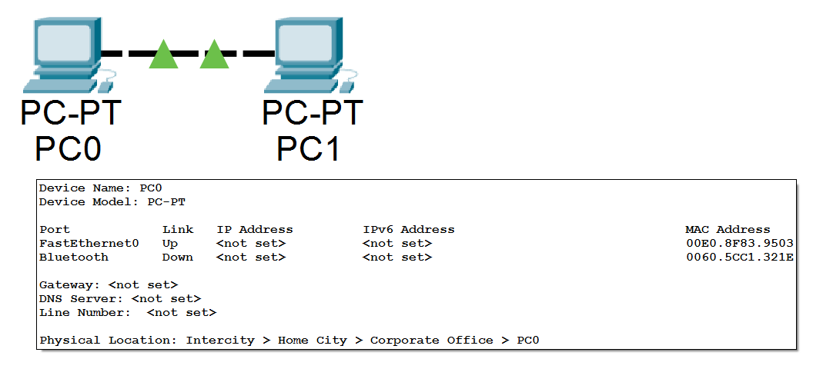
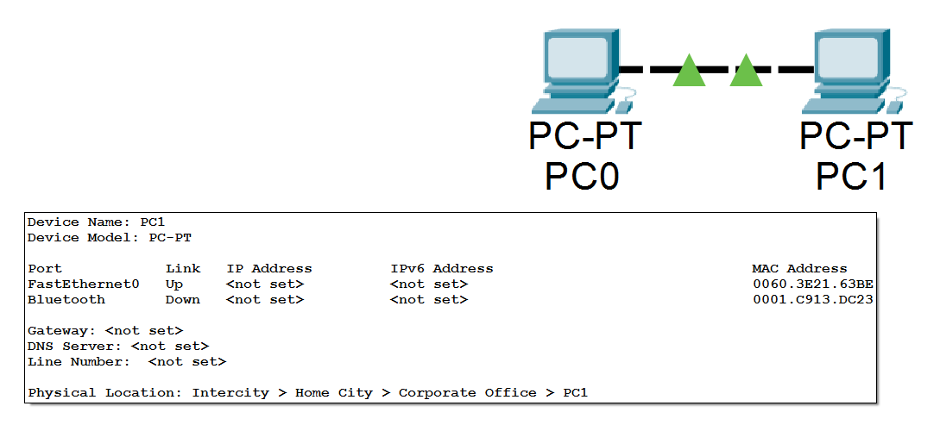
Step-by-Step Guide
1
2
Bring the Computers onto the Screen
Connect the Computers with a Cable
Think of the big white screen as your empty desk — let's place two PCs on it.
Because we are connecting two of the same type of device (PC to PC), we must use a Copper Cross-Over cable.
Look at the bottom-left corner. Click the End Devices icon (small computer and phone).
In the menu next to it, click the first icon labeled PC.
Click once on the white workspace — PC0 appears.
Repeat to place a second computer — it will be named PC1.
Click the Connections icon (orange lightning bolt) at the bottom-left.
Select the black dashed line — hover to confirm it says Copper Cross-Over.
Click PC0, then select FastEthernet0 from the pop-up menu.
Drag to PC1, click it, and choose FastEthernet0 again.
Look for a dashed line with green triangles at both ends — green means the cable is connected correctly!

Slide 12
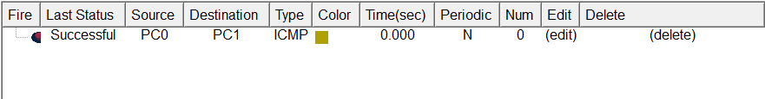
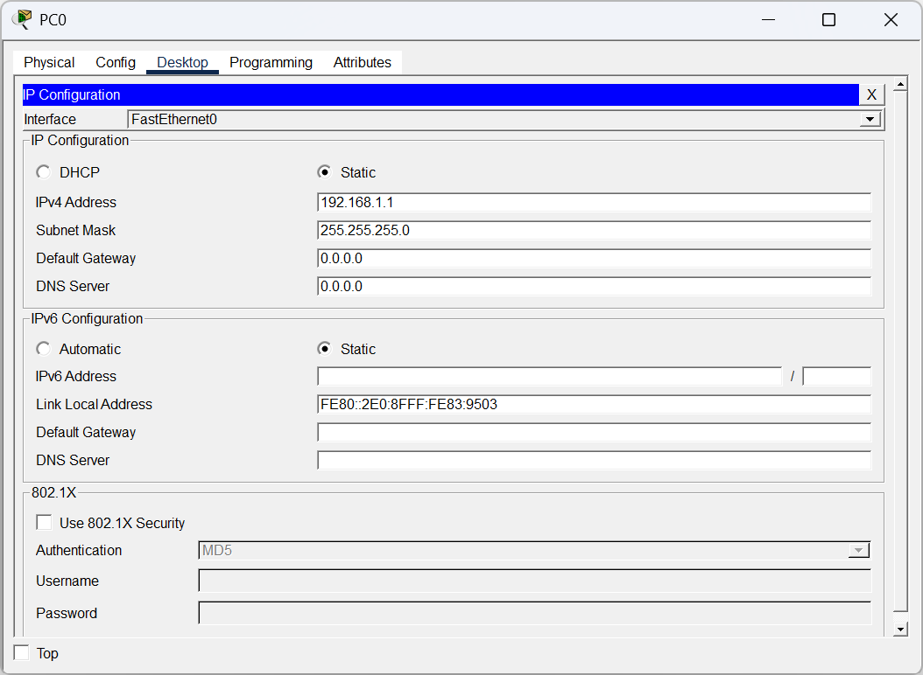
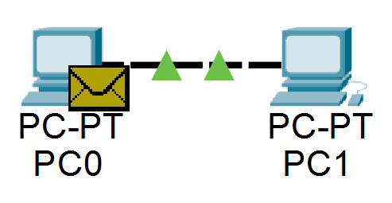
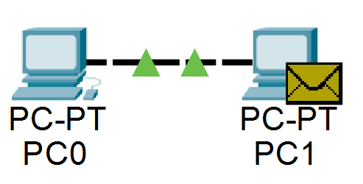
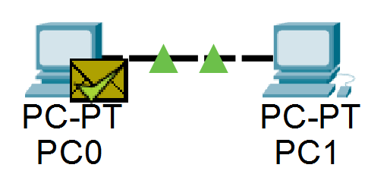

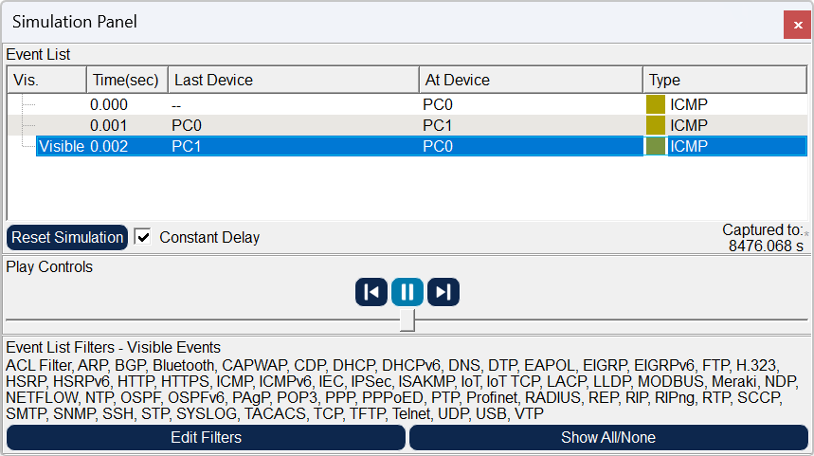

Step-by-Step Guide
3
4
Give the Computers an IP Address
Test the Network — Send a Digital Letter
Computers need an IP address to know who they're talking to, just like houses need street numbers for the mail carrier.
Let's confirm PC0 can successfully send a message to PC1 using the visual envelope tool.
Click PC0 → Desktop tab → IP Configuration.
In IPv4 Address, type: 192.168.1.1
Click the Subnet Mask box — it auto-fills with 255.255.255.0. Leave it as is.
Close the PC0 window.
Repeat for PC1: Desktop → IP Configuration → IPv4 Address: 192.168.1.2 (ends in '2' — every computer needs a unique address).
Auto-fill Subnet Mask and close the window.
Find the yellow envelope icon near the top-right toolbar (Add Simple PDU). Click it.
Your cursor becomes an envelope. Click PC0 (sender), then PC1 (receiver).
Check the bottom-right corner — a new line should appear with Successful under the "Status" column.
🎉 Congratulations! You have successfully built, configured, and tested your very first computer network.

Slide 13
Lab #4: Ethernet Cables, Categories, RJ45 Connectors & Wiring Standards
By the end of this lab, you will understand Ethernet cable structure, cable categories, RJ45 connectors, T568A/B wiring standards, and how to choose the correct cable in Cisco Packet Tracer.
Lab Outcomes
Ethernet Cable Structure
Understand what an Ethernet cable is and why the wires inside are twisted.
Cable Categories
Explain the difference between cable categories (like Cat5 and Cat6).
RJ45 Connector
Identify an RJ45 connector and its purpose.
Wiring Standards
Understand the two main color-coding standards (T568A and T568B).
Cisco Packet Tracer
Know exactly when to choose a "Straight-Through" or "Cross-Over" cable in Cisco Packet Tracer.
Step 1: Understanding the Ethernet Cable
Think of an Ethernet cable as a physical highway for digital data. It connects computers, routers, and switches together.
8 Tiny Wires
4 Twisted Pairs
Why Twist Them?
If you were to cut open an Ethernet cable, you would not see one big wire. Instead, you would see 8 tiny, color-coded wires.
These 8 wires are twisted together in pairs (4 pairs total).
Twisting the wires acts like an invisible shield. It stops outside electrical noise (like from lights or microwaves) from messing up the data traveling inside. This is called a "Twisted Pair" cable.
Step 2: Cable Categories (Cat)
When you buy these cables, they have names like "Cat5e" or "Cat6." "Cat" is just short for Category. Think of these categories like speed limits on a highway:
Cat5
Cat5e
Cat6
An older, slower highway. Rarely used anymore.
The "e" stands for enhanced. It is a standard highway, good for normal internet speeds (up to 1 Gigabit per second).
A superhighway. The wires inside are twisted tighter and have better shielding, allowing for much faster data speeds.

Slide 14
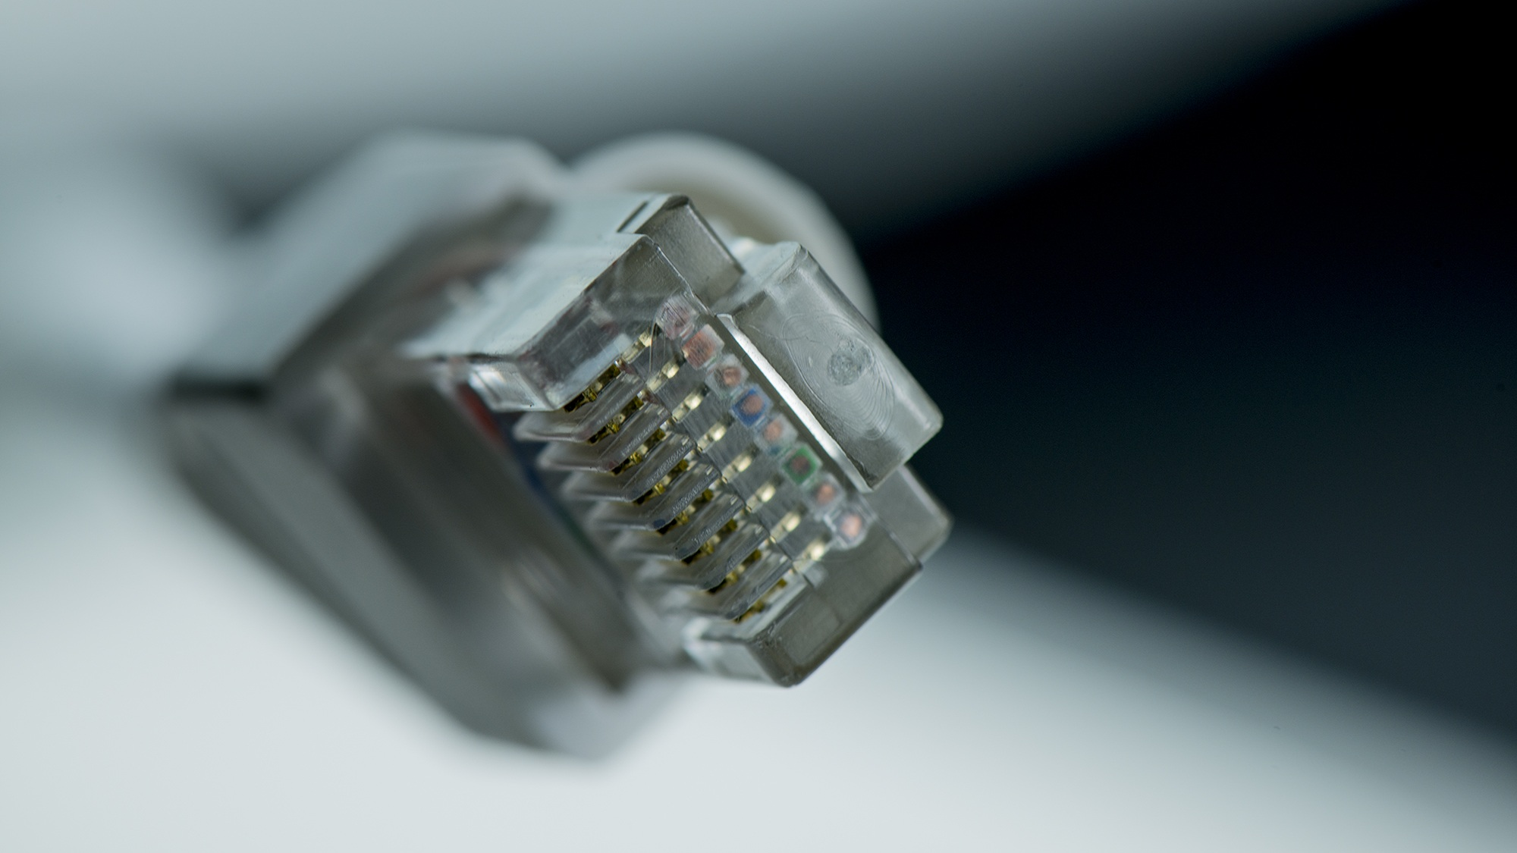

RJ45 Connectors & Wiring Standards
Step 3: The RJ45 Connector
To plug this cable into a computer, the 8 tiny wires need a plug. This plastic plug is called an RJ45 connector.
It looks exactly like a clear plastic landline phone plug, but slightly wider.
If you look closely at an RJ45 connector, it has 8 tiny gold pins. Each of the 8 colored wires inside the cable matches up perfectly with one of these gold pins.
Step 4: Wiring Standards (The Color Codes)
Because there are 8 colored wires (Orange, Green, Blue, Brown, and striped versions of each), we need a universal rule for what order to put them in before we crimp the plastic RJ45 plug onto them. Engineers created two standard color patterns:
1
2
T568A Pattern
T568B Pattern
Starts with the Green-Striped wire.
Starts with the Orange-Striped wire. (This is the most common one used today).
Note for the student: You don't have to memorize the exact color order right now, just know that A and B are the two accepted "recipes" for arranging the wires.
Step 5: Applying This in Cisco Packet Tracer
In Packet Tracer, you don't have to strip wires or use plastic plugs! You just have to click the right cable. Here is how these physical rules apply to your software GUI:
The Straight-Through Cable (Solid Black Line in PT)
The Cross-Over Cable (Dashed Black Line in PT)
Physical Rule: Both ends of the cable use the exact same color recipe (T568A on one end, and T568A on the other end).
Packet Tracer Rule: Use this solid black line to connect DIFFERENT types of devices. (Example: A PC to a Switch, or a Switch to a Router).
Physical Rule: The cable uses different recipes on each end (T568A on one end, and T568B on the other end). This "crosses" the sending and receiving wires so the devices don't talk over each other.
Packet Tracer Rule: Use this dashed black line to connect the SAME types of devices. (Example: A PC to a PC, or a Switch to a Switch). You actually used this cable in Lab 3!

Slide 15

CISCO PACKET TRACER
Lab #5: Making a Local Area Network (LAN) Using a Switch
In this lab, you will build a fully functioning Local Area Network by connecting three computers to a network switch using straight-through cables, assigning IP addresses, and testing communication between all devices.

Slide 16
Lab Outcomes & Step-by-Step Guide
By the end of this lab, you will be able to:
Step 1: Bring the Devices onto the Screen
Let's build a network with three computers and one switch.
Understand the purpose of a Network Switch
Place a Switch onto the Cisco Packet Tracer workspace
Apply the rule from Lab 4 to choose the correct cable (Straight-Through)
Connect multiple computers to form a Local Area Network (LAN)
Test the network to ensure any computer can talk to any other computer
Look at the bottom-left corner. Click on End Devices (the computer/phone icon).
Click on the PC icon and place three computers onto your white workspace. (They will be named PC0, PC1, and PC2).
Now, let's get the Switch. Go back to the bottom-left corner and click on Network Devices (it looks like a router/circle with arrows).
In the menu right next to it, click on Switches (it looks like a little rectangular box).
Choose the very first switch in the list (it is named 2960). Click it, and then click in the middle of your workspace to place it.
Step 2: Wire the Network Together
Since a Computer and a Switch are different types of devices, remember your rule from Lab 4: we must use a Straight-Through cable!
Click on the Connections icon (the orange lightning bolt).
Look for the solid black line (Copper Straight-Through) and click it.
Click on PC0 and select FastEthernet0.
Drag your mouse to the Switch and click on it. A long list will pop up! This is because a switch has lots of ports. Click on the very first one: FastEthernet0/1.
Repeat this for the other computers:
Grab another solid black cable. Click PC1 (FastEthernet0) and connect it to the Switch (FastEthernet0/2).
Grab a third solid black cable. Click PC2 (FastEthernet0) and connect it to the Switch (FastEthernet0/3).
Important Wait Time: You will notice the little triangles on the switch side of the cables are orange. A real switch takes about 30 seconds to turn on and check the cables. Wait until those orange dots turn green.

Slide 17

IP Configuration & Testing Your LAN
1
2
Step 3: Give the Computers their IP Addresses
Step 4: Test Your New LAN!
Let's make sure the switch is doing its job as the middleman.
They are physically plugged in, but they still need their digital street addresses to talk to each other.
Click the closed yellow envelope icon (Add Simple PDU) near the top-right toolbar.
Click on PC0 (the sender).
Click on PC2 (the receiver).
Look at the bottom-right corner in the status window. It should say Successful!
Try it again! Grab a new envelope, click on PC2, and send it to PC1. It should also be Successful.
Click on PC0. Go to the Desktop tab -> IP Configuration.
Type in the IPv4 Address: 192.168.1.1 and click the Subnet Mask box so it auto-fills (255.255.255.0). Close the window.
Click on PC1. Go to Desktop -> IP Configuration.
Type in the IPv4 Address: 192.168.1.2 and click the Subnet Mask box. Close the window.
Click on PC2. Go to Desktop -> IP Configuration.
Type in the IPv4 Address: 192.168.1.3 and click the Subnet Mask box. Close the window.
Congratulations! You have just built a fully functioning Local Area Network (LAN). All the computers can now safely share data with each other through the Switch.

Slide 18

Lab # 6: Repeaters & Routers with Switches & Hubs
As networks get bigger, we need different tools to handle the traffic. In this lab, we are going to build two separate towns (networks) and connect them.
First, here is a quick cheat sheet on the devices we are using so a 10th-grade student can easily understand them:
Hub — The Megaphone
Switch — The Smart Mailman
An older device. If one computer sends a message, the Hub shouts it to every computer plugged into it. It is noisy and not very smart.
You used this in Lab 5! It looks at the address on the message and delivers it only to the correct computer.
Repeater — The Energy Drink
Router — The Border Gate
If a cable is too long, the digital signal gets tired and weak. A repeater takes the weak signal, boosts it back to 100%, and sends it on its way.
Switches and Hubs can only connect computers in the same town. A Router connects different towns together so they can share data.

Slide 19
Lab Outcomes & Step 1: Place the Devices
By the end of this lab, you will be able to:
Step 1: Place the Devices on Your Workspace
We are going to build "Town A" on the left, "Town B" on the right, and put a Router in the middle to connect them.
Understand the difference between a Hub, Switch, Repeater, and Router
Use the "Auto-Connect" magic cable tool in Packet Tracer
Configure a Router using the visual GUI (without typing complex code)
Set up a "Default Gateway" on a computer so it knows how to send messages to a different network
The Computers: Go to End Devices and place one PC on the far left (PC0) and one PC on the far right (PC1).
The Hub (Town A): Go to Network Devices → Hubs (next to the switches) → click PT-Hub and place it next to PC0.
The Switch (Town B): Go to Network Devices → Switches → click the 2960 switch and place it next to PC1.
The Repeater (Town B): Go to Network Devices → Wireless Devices (or sometimes found under Hubs depending on the version). Look for PT-Repeater and place it between your Switch and the middle of the screen.
The Router (The Middle): Go to Network Devices → Routers → click the first one named PT-Router (this is a generic, beginner-friendly router). Place it dead in the center of your screen.

Slide 20
Step 2: Wire It All Together & Step 3: Turn on the Router
Step 2: Wire it All Together (The Magic Cable)
Because we have so many different devices, remembering which cable to use (Straight-Through vs. Cross-Over) can be tricky. Let's learn a new trick!
Click the Connections icon (the orange lightning bolt).
In the cable menu, click the first icon (it looks like a yellow lightning bolt with sparkles). This is the "Auto Choose" tool. It will pick the perfect cable for you automatically!
Click PC0 and then click the Hub. (Town A is wired).
Click the Hub and then click the Router. (Town A is connected to the gate).
Click PC1 and then click the Switch.
Click the Switch and then click the Repeater.
Click the Repeater and then click the Router. (Town B is wired and connected to the gate).
Note: Wait for the little orange circles on the switch to turn green before moving on!
Step 3: Turn on the Router (The Border Gate)
Right now, the connections touching the Router have red triangles. That means the gates are closed. Let's open them!
Click on the Router. A window will pop up.
At the top, click on the Config tab.
Look at the menu on the left side. Under the word "INTERFACE", click on FastEthernet0/0 (this is the gate pointing to Town A).
Look for the box that says Port Status and check the box next to On. (You will see the red triangle turn green on your workspace!).
In the IPv4 Address box, type Town A's gate address: 192.168.1.254
Click the Subnet Mask box so it auto-fills, then go back to the left menu.
Click on FastEthernet0/1 (this is the gate pointing to Town B).
Check the Port Status: On box.
In the IPv4 Address box, type Town B's gate address: 192.168.2.254
Click the Subnet Mask box so it auto-fills. Close the Router window.

Slide 21

Step 4: Configure the Computers & Step 5: Test the Connection
Step 4: Configure the Computers
Step 5: Test the Long-Distance Connection!
The computers need their own IP addresses, but they ALSO need to know the address of the Router so they can send mail out of their town. This is called the Default Gateway.
Grab the closed yellow envelope (Add Simple PDU) from the top toolbar.
Click on PC0 (Sender in Town A).
Click on PC1 (Receiver in Town B).
Look at the bottom-right status window.
PC0 (Town A):
Click PC0 (in Town A). Go to Desktop → IP Configuration.
IPv4 Address: 192.168.1.1
Click Subnet Mask so it auto-fills.
Default Gateway: Type in Town A's gate address: 192.168.1.254. Close the window.
Important 10th Grade Tip: The very first time a router tries to find a new town, it drops the first package while it draws a map. If it says "Failed", do not panic! Just click the "Fire" button (double-click the red "Failed" text, or just send a brand new envelope from PC0 to PC1).
PC1 (Town B):
Click PC1 (in Town B). Go to Desktop → IP Configuration.
IPv4 Address: 192.168.2.1 (Notice it is a '2', because it is a different town!)
Click Subnet Mask so it auto-fills.
Default Gateway: Type in Town B's gate address: 192.168.2.254. Close the window.
The second attempt will say Successful. Your towns are communicating!

Slide 22
LAB #7
Lab # 7 : Router Configuration
In this lab, you will configure a router to connect two separate networks and verify that it can successfully pass messages between them using Cisco Packet Tracer.
Lab Outcomes
Router Fundamentals
Naming & IP Configuration
Understand the main job of a Network Router.
Change the name of a Router using the graphical interface and configure IP addresses on different Router ports (interfaces).
Default Gateway
Verification
Understand why the Router acts as the "Default Gateway" for computers.
Prove that your configured Router can successfully pass messages between two different networks.
Lab Work: Building the Network
Step 1: Build the Two Networks
Step 2: Give the Router a Name
Place two PCs (PC0 left, PC1 right), a 2960 Switch next to each, and the PT-Router in the middle. Use the Magic Auto-Connect Cable (yellow lightning bolt) to wire them up:
Click the Router → Config tab → Settings under "GLOBAL". Change both Display Name and Hostname to Main_Post_Office. (Notice the underscore — network names don't like spaces!)
PC0 → Switch0
Switch0 → Router
PC1 → Switch1
Switch1 → Router
Step 3: Configure the Router's Ports
Stay on the Config tab. Under "INTERFACE":
FastEthernet0/0 (left network): Port Status On, IPv4 192.168.1.1
FastEthernet0/1 (right network): Port Status On, IPv4 192.168.2.1
Red triangles will turn green once ports are active.

Slide 23
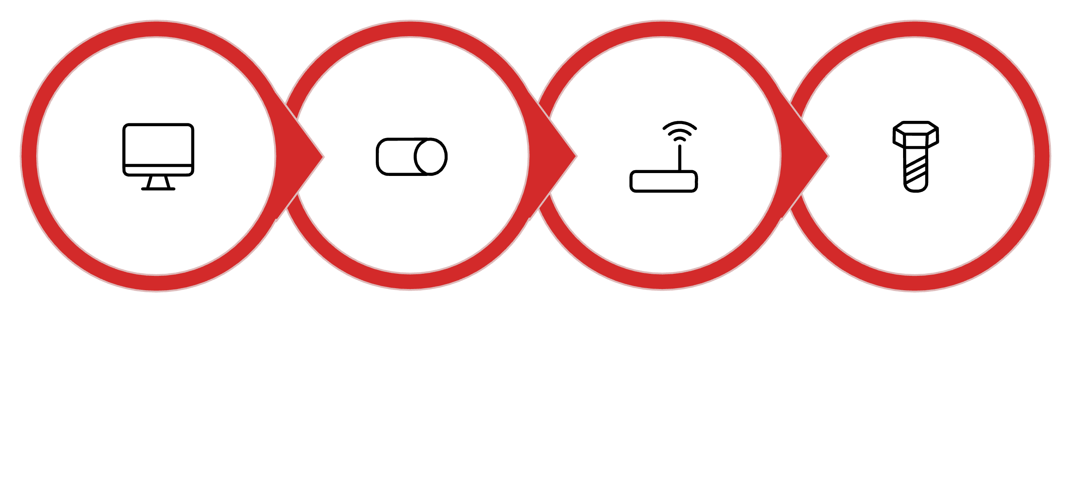

Place Devices
Add Switches
Position Router
Auto-Connect Cables
Following these four steps in order ensures a clean physical topology before moving on to IP configuration.
Configuring PCs & Testing the Router
1
2
3
Step 4: Set the Default Gateway on PC0
Step 4 (continued): Set the Default Gateway on PC1
Step 5: Test the Router!
Click PC0 → Desktop → IP Configuration. Set IPv4 Address to 192.168.1.10, click the Subnet Mask box, and set Default Gateway to 192.168.1.1 (the router's left-side address).
Grab the closed yellow envelope from the toolbar. Click PC0 then PC1. The first message will say Failed — the router is drawing its map. Double-click the red text or send a new envelope. The second time it will say Successful! 🎉
Click PC1 → Desktop → IP Configuration. Set IPv4 Address to 192.168.2.10, click the Subnet Mask box, and set Default Gateway to 192.168.2.1 (the router's right-side address).
💡 Tip: The router must build its routing table the very first time a message crosses networks. That is why the initial ping or envelope always fails — simply retry and it will succeed.

Slide 24
Lab #8: Building an Advanced Network
Routers, Switches, Bridges, PCs & Laptops — using Cisco Packet Tracer
By the end of this lab, you will be able to:
Add Laptops to your Packet Tracer workspace and configure them.
Understand the difference between a Bridge (connects the same network) and a Router (connects different networks).
Use a Network Bridge to connect two Switches together.
Build a large, multi-part network using the graphical interface.
Lab Work: Step-by-Step Guide
Step 1: Place the Devices — Building Our Two Towns
We are going to build Town A (which is so big it needs two switches and a bridge) and Town B. Then, we will put a Router in the middle to connect the two towns.
1
2
3
The Middle (The Gate)
Town A (Left Side)
Town B (Right Side)
Go to Routers and place a PT-Router in the top center of your screen.
Go to Switches and place two 2960 Switches on the left side of your screen.
Go to Network Devices → Switches, look for the PT-Bridge (it looks like a small box with two arrows), and place it right between your two switches.
Go to End Devices. Place one PC on the first switch, and one Laptop on the second switch.
Place one 2960 Switch on the right side of your screen.
Go to End Devices and place one PC and one Laptop near this switch.

Slide 25
Step 2: Wire It All Together — Using the Magic Cable
Because we have a lot of devices, we will use the "Auto Choose" cable to prevent mistakes.
Click the Connections icon (the orange lightning bolt). Click the first icon (the yellow lightning bolt with sparkles).
Wire Town A
Wire Town B
Connect to the Router
Click the PC and connect it to the first Switch.
Click the first Switch and connect it to the Bridge.
Click the Bridge and connect it to the second Switch.
Click the Laptop and connect it to the second Switch.
Connect the PC to Town B's Switch.
Connect the Laptop to Town B's Switch.
Connect Town A's first Switch to the Router.
Connect Town B's Switch to the Router.
Wait for the orange dots on the switches to turn green!
Configuration & Testing
Step 3: Turn on the Router (The Main Post Office)
Click on the Router → go to the Config tab.
On the left menu, click FastEthernet0/0 (pointing to Town A).
Check Port Status: On. Set IPv4 Address to: 192.168.1.254 (Click Subnet Mask to auto-fill).
On the left menu, click FastEthernet0/1 (pointing to Town B).
Check Port Status: On. Set IPv4 Address to: 192.168.2.254 (Click Subnet Mask to auto-fill). Close the window.
Step 4: Configure the Computers and Laptops
Laptops work exactly like PCs in Packet Tracer! Because Town A has a Bridge, both switches in Town A share the exact same IP neighborhood.
Device
IPv4 Address
Subnet
Default Gateway
Network
Town A – PC
192.168.1.1
Auto-fill
192.168.1.254
Town A (Bridge)
Town A – Laptop
192.168.1.2
Auto-fill
192.168.1.254
Town A (Bridge)
Town B – PC
192.168.2.1
Auto-fill
192.168.2.254
Town B
Town B – Laptop
192.168.2.2
Auto-fill
192.168.2.254
Town B

Slide 26

Notice: Town A devices use .1.x addresses because the Bridge keeps them in the same town. Town B devices use .2.x because they are in a different network!
Step 5: Test the Entire Network!
Let's make sure the Bridge and the Router are doing their jobs.
🔵 Test the Bridge
🔴 Test the Router
Grab the closed yellow envelope (Add Simple PDU). Click Town A's PC and send a message to Town A's Laptop.
Grab a new envelope. Click Town A's Laptop and send a message to Town B's Laptop.
It should say Successful immediately. The Bridge successfully passed the message between the two switches!
Remember: The first attempt across a router always says Failed while it draws a map. Double-click the red "Failed" text (or send a new envelope). The second try will say Successful!
🎉 Amazing work! You just built a highly advanced network using Laptops, PCs, Switches, a Bridge, and a Router, all communicating perfectly.

Slide 27
Lab 9: Exploring Everyday Network Devices
In your previous labs, you used Switches, Bridges, and Routers to move data around. Now, we are going to look at Network Devices you use every single day in the real world: WiFi Routers, Smartphones, and Servers.
Your Quick Cheat Sheet
Before we begin, get familiar with the three key devices you'll be working with in this lab.
The Server (The Digital Library)
The Home Router (The WiFi Box)
Smart Device (Phones/Tablets)
A super-computer that holds websites, videos, or files, and "serves" them to anyone who asks.
This is the box you have at home. It is actually three devices in one! It is a Switch (has ports on the back), a Router (connects to the internet), and an Access Point (gives out invisible WiFi signals).
Devices that have no cables and connect through the air.
Lab Outcomes
By the end of this lab, you will be able to:
Identify and place a Server, a Home WiFi Router, and a Smartphone in Packet Tracer.
Understand the magic of DHCP (how devices get IP addresses automatically without you typing them).
Connect a wireless device to a network without any cables.
Use the graphical Web Browser on a virtual computer to view a website hosted on your Server.

Slide 28
Lab Work: Step-by-Step Guide
We are going to build a network that looks exactly like a normal house or a small coffee shop.
Step 1: Bring the New Devices onto the Screen
Step 2: Plug in the Wired Devices
Let's plug our Server and our PC into the back of the Home Router.
The WiFi Box: Go to Network Devices → Wireless Devices. Look for Home Router (or WRT300N) and place it in the centre of your screen.
The Server: Go to End Devices. Click the Server icon (tall computer tower) and place it on the left.
The Wired PC: Stay in End Devices and place a normal PC near the router.
The Wireless Phone: Place a Smart Device (Smartphone) on the right. Look closely! Within a few seconds, magical wavy lines should appear between the Smartphone and the Home Router — it connected to the WiFi all by itself!
Click the Connections icon (the orange lightning bolt).
Click the Magic Auto-Connect Cable (the yellow lightning bolt with sparkles).
Click the Server and then click the Home Router.
Click the PC and then click the Home Router. Wait for the little orange dots on the cables to turn green!

Slide 29

Configuration & Testing
1
2
3
Step 3: Setup the Server (The Website Host)
Step 4: The Magic of DHCP (Automatic IP Addresses)
Step 5: Test the Network — Surf the Web!
The server needs a permanent IP address so our devices know exactly where to find the website.
In previous labs, you had to type the IP address for every single computer. In the real world, your Home Router hands them out automatically using a feature called DHCP! Let's turn it on.
Instead of sending a boring digital envelope, let's actually load a webpage from our Server!
Click on the Server.
Go to Desktop tab → IP Configuration.
Type 192.168.0.100 in the IPv4 Address box.
Click the Subnet Mask box so it auto-fills (255.255.255.0).
Close the window.
Click on your PC → Desktop tab → click the Web Browser icon (little blue globe).
A blank web browser will open. In the URL bar at the top, type: 192.168.0.100
Click Go. Success! You should see a blue screen that says "Cisco Packet Tracer" with welcome text. You just accessed a website!
Bonus Test: Close the PC window. Click on your Smartphone, open its Web Browser, and type 192.168.0.100. Click Go. Your wireless phone can see the website too!
Click on your PC → Desktop → IP Configuration.
Instead of typing numbers, click the little circle button next to DHCP (it defaults to Static).
Wait two seconds. You will see the boxes magically fill themselves with numbers (like 192.168.0.101)! Next to it, it will say "DHCP request successful." Close the window.
Click on your Smartphone → Desktop → IP Configuration. Notice that DHCP is already selected, and it already gave itself an IP address (like 192.168.0.102).
🎉 Congratulations! You have just set up a realistic, modern network featuring a Server, an automatic WiFi Router, and both wired and wireless devices.

Slide 30
Lab # 10: Static Routing
DRAWING THE MAP
In this lab, you will connect two routers together, understand why routers drop messages when they don't know the destination, use the GUI to configure a static route (manually teaching the router a new path), and successfully send a message across a multi-router network.
🔗 Connect Routers
🗺️ Understand Routing
Connect two different routers together
Understand why routers drop messages when they don't know the destination
⚙️ Configure Static Routes
✅ Send Messages
Use the GUI to configure a "Static Route" — manually teaching the router a new path
Successfully send a message across a multi-router network
Lab Work: Building & Configuring the Network
Step 1: Build the World
Step 3: Configure Router Ports
Two towns, two post offices. Place PC0, a 2960 Switch, and Router0 on the left. Place PC1, a 2960 Switch, and Router1 on the right.
Router0 — FastEthernet0/0 (Town A): 192.168.1.1 / FastEthernet0/1 (to Router1): 10.0.0.1
Step 2: Wire It Together
Router1 — FastEthernet0/0 (Town B): 192.168.2.1 / FastEthernet0/1 (to Router0): 10.0.0.2
Use the Auto-Connect Cable (yellow lightning bolt):
Step 4: Configure the PCs
PC0 → Left Switch
Left Switch → Router0
PC1 → Right Switch
Right Switch → Router1
Router0 → Router1 (red cable is normal!)
PC0: IPv4 192.168.1.10 · Gateway 192.168.1.1
PC1: IPv4 192.168.2.10 · Gateway 192.168.2.1

Slide 31
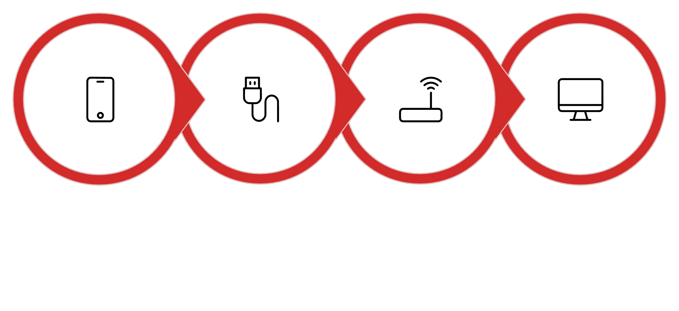
Place Devices
Connect Cables
Configure Routers
Configure PCs
Once configured, the router-to-router cable should show green dots — your physical link is live!
Static Routing & The Final Test
Step 5: The Problem
Step 7: The Final Test! 🎉
Send a yellow envelope from PC0 → PC1. It says Failed! Router0 has no idea where 192.168.2.0 is — its map is blank. Let's draw the map.
Grab a brand new yellow envelope. Click PC0, then PC1.
Step 6: Give the Routers the Map
It might fail on the very first try while routers update their maps — send a second envelope and it will say Successful!
Router0 → Config → ROUTING → Static → Add:
Network: 192.168.2.0 (Town B)
Mask: 255.255.255.0
Next Hop: 10.0.0.2 (Router1)
Both routers now know exactly how to forward mail in both directions. The map is complete!
Router1 → Config → ROUTING → Static → Add:
Network: 192.168.1.0 (Town A)
Mask: 255.255.255.0
Next Hop: 10.0.0.1 (Router0)

Slide 32
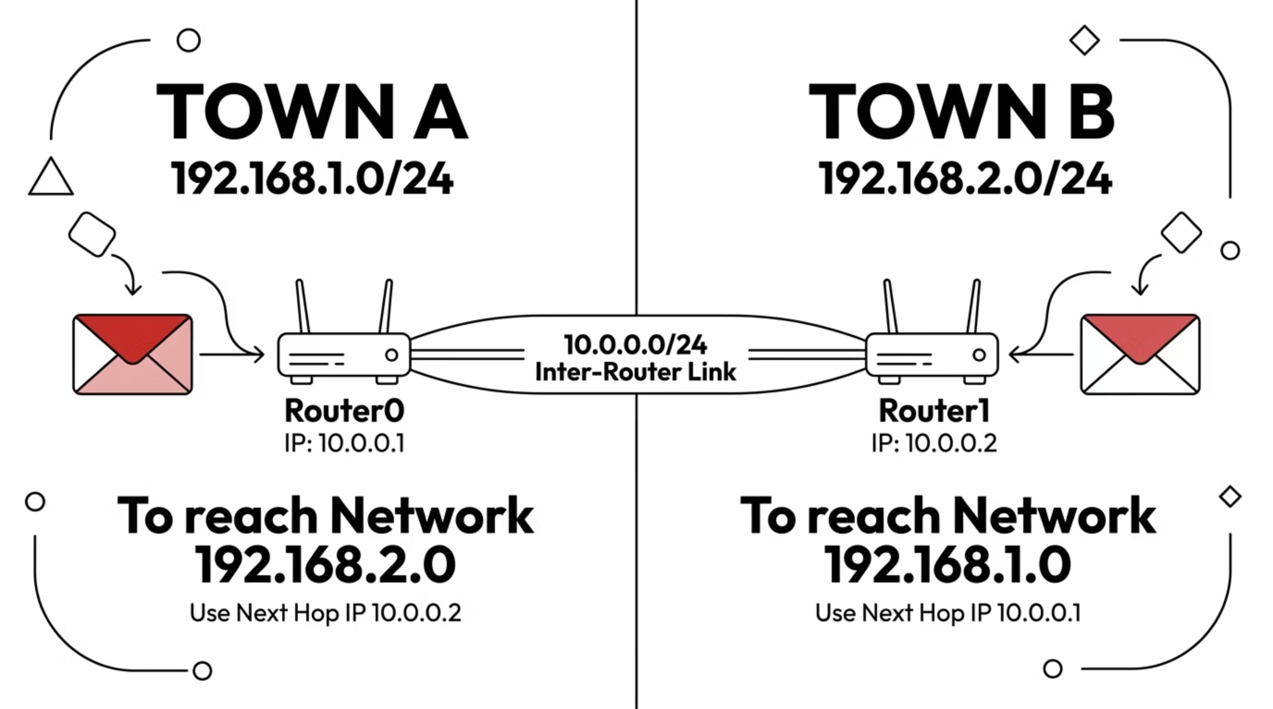
This infographic shows the bidirectional static routes configured on each router, enabling mail to flow between Town A and Town B through the shared inter-router link.

